Slide 1
Total Participation Techniques

Slide 2

Jot Thought
When you hear the word PARTICIPATION what do you think?
When you hear the word ENGAGEMENT what do you think?
Notes:
Talk to your partner/team about the terms you heard. Place them in the t-chart on the side for participation or engagement. Were there any similarities or differences?

Slide 3
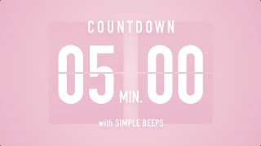
Jot Thought
Make a t-chart with your table
Label one side participation, one side engagement
Sort stickies into the t-chart
Share with your team
Do you notice any similarities or differences between the sides?
Notes:
Talk to your partner/team about the terms you heard. Place them in the t-chart on the side for participation or engagement. Were there any similarities or differences?

Slide 4
Haven’t We Done this already?
Kagan
Think Pair Share
That one "structure"
Restorative Practice
TPT ideas
Bloom's Taxonomy

Slide 5
Levels of engagement:
01
02
03
Rebellion
Retreatism
Ritual Compliance
04
05
Strategic Compliance
Engagement
Number your sticky note 1 through 5
As you watch write down a student initials you think falls into this category.
Notes:
Does your partner teacher have the same kid in the same category? Why or why not?

Slide 6

Click to watch!
https://youtu.be/256hluHbp2o?si=7xBgLun7MVIcTcuW

Slide 7

Levels of engagement:
01
02
03
Rebellion
Retreatism
Ritual Compliance
04
05
Strategic Compliance
Engagement
Discuss:
What student(s) did you put?
If you have a partner teacher, was it the same?
Notes:
Does your partner teacher have the same kid in the same category? Why or why not?

Slide 8
Why is this important?
Break the stereotype:
Just because a student looks engaged, are they really learning?
Self- Reflection:
Is my teaching really effective?
Marzano Indicators:
Tracks effectiveness like- organize to deepen understanding, process new information, manage response rates

Slide 9
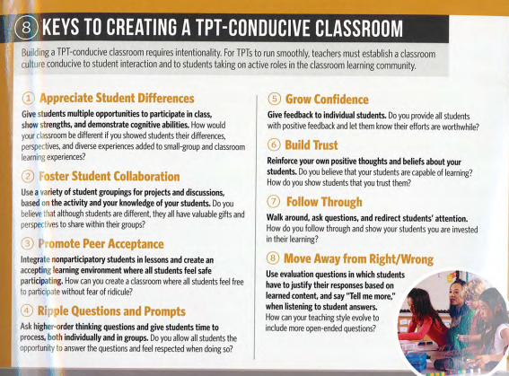
How can we do this?
GOAL: To simply tweak current instruction in small ways to be more effective and incorporate ALL students
8 Participation Keys
Appreciate Student Differences
Foster Student Collaboration
Promote Peer Acceptance
Ripple Questions and Prompts
Grow Confidence
Build Trust
Follow Through
Move Away From Right/Wrong
Pg. 6

Slide 10
How can we do this?
GOAL: To simply tweak current instruction in small ways to be more effective and incorporate ALL students
8 Participation Keys
Appreciate Student Differences
Foster Student Collaboration
Promote Peer Acceptance
Ripple Questions and Prompts
Grow Confidence
Build Trust
Follow Through
Move Away From Right/Wrong
Pg. 6
A: Share a key takeaway from these
B: Why do you think these are important?

Slide 11
Intentionality

Slide 12
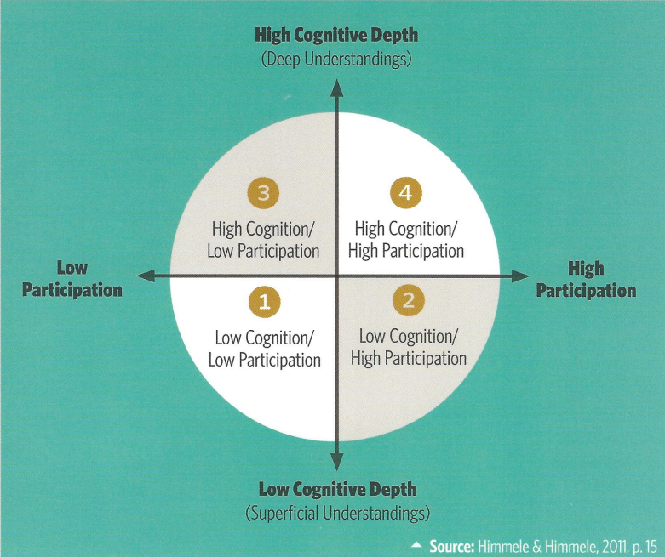
Cognitive Engagement Model
Pg. 3

Slide 13
Quadrant Analysis
Pg. 3- Read through the model description to better understand each quadrant

Slide 14
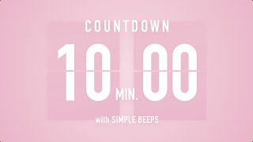
Quadrant Analysis
Pg. 3- Read through the model description to better understand each quadrant
Work with your team to sort out the situation cards, thinking:
In what quadrant would this fall?
How can we move some of them in Q1 to a different quadrant?

Slide 15
Quadrant Analysis
What can I do?
Did any stick out to you?
What is a current strategy you’re using? What small tweak can you make to it to move it to a different quadrant?
Pg. 8
sample strategies

Slide 16
You don’t need a ton of strategies
just pick a couple that work for your grade/skill and rotate throughout lessons!

Slide 17
How can we do this?
GOAL: To simply tweak current instruction in small ways to be more effective and incorporate ALL students
8 Participation Keys
Appreciate Student Differences (Restorative Practices)
Foster Student Collaboration (Student Discourse with Melin)
Promote Peer Acceptance (RP/Harmony)
Ripple Questions and Prompts (Discourse and RP)
Grow Confidence (Data chats in your classroom)
Build Trust (Restorative Practices and teacher relationships)
Follow Through (Strategies)
Move Away From Right/Wrong (Math Pact PD)

Slide 18
Exit Ticket
Take 2 dot stickers and put 1 on each chart
Which of the 8 keys do you think is most important or most valuable?
Which technique would you like to implement more in your classroom?
01

